Slide 1


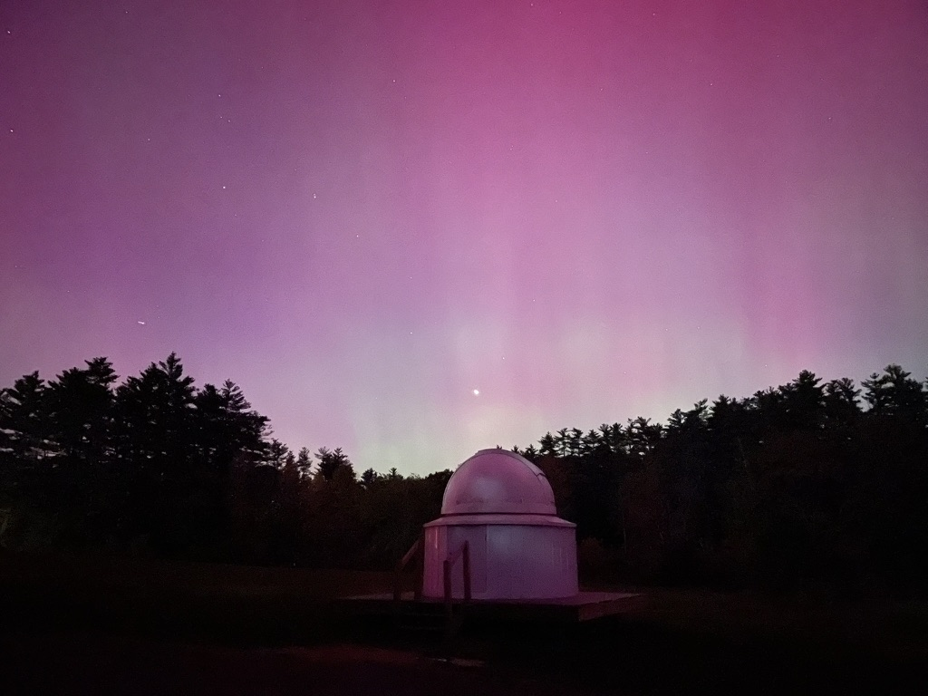
Nature Friendly Lighting in Durham
Project Team: Hayden Anastasio, Bennett Murphy, Alex Soucy, Will Cleaveland
Project Advisor: Paul Rasmussen (Town of Durham)
Own Work
Notes:
Will: Talk about picture and light pollution in Durham

Slide 2
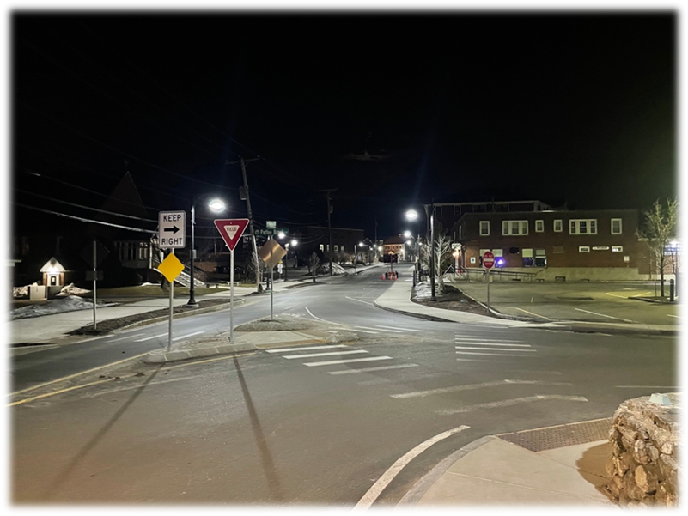

Introduction
Outdoor lighting is vital part of nighttime activities
Negative effects on human health and the environment
Disrupts wildlife behavior, circadian rhythms, and limits observation of night sky
Durham impacted areas: wetlands, rivers, estuaries, forested areas, and fields
DarkSky: international organization reducing light pollution through
- Education
- Engaging with communities and manufacturers
- Certifying products that lessen artificial sky glow
Own Work
Notes:
As we all know, outdoor lighting is important. It allows for nighttime work and recreational activities to become a safer and more comfortable experience.
Over time though, the negative effects of artificial light at night on human health and the environment have become apparent.
This is because light pollution disrupts wildlife behavior, circadian rhythms, and limits observation of the night sky.
This project is particularly important to Durham since it contains a multitude of impacted areas such as wetlands, rivers, estuaries, forested areas, and fields.
The main nature-based resource for this research project has been DarkSky, which is an international organization dedicated to reducing light pollution through education, engaging with communities and manufacturers, and certifying products that lessen artificial sky glow for the benefit of humans and animals alike

Slide 3
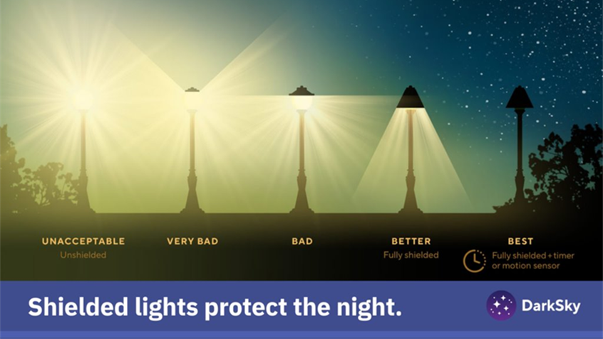
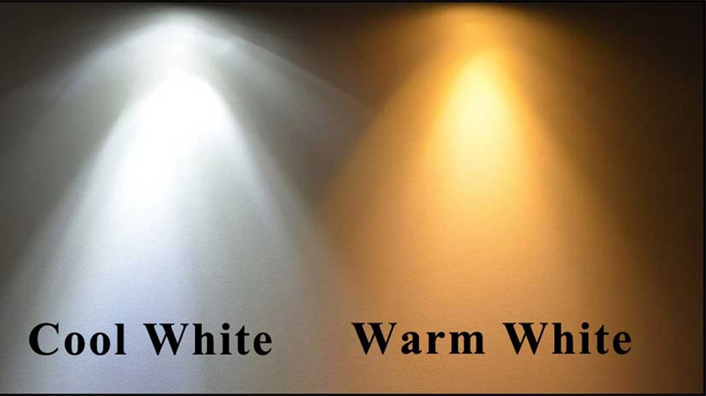
Light Pollution Impacts
Wildlife:
Excessive and poorly directed lighting disrupts natural patterns of migration, feeding, and sleep à leading to death among animals
Humans:
Eye and sleep health is harmed by intense light, especially whitish-blue colors in the evening
Sky Visibility:
Light pollution produces skyglow; limits observation of stars and degrades rural character of this town
Source: Warm White Vs Cool White Lights | Know The Actual Difference
Notes:
So there are several negative impacts due to light pollution. For example, Wildlife do not appreciate excessive and poorly directed lighting because it disrupts their natural patterns of migration, feeding, and sleep. This causes exhaustion and disorientation which can even lead to death among animals. For Humans, we are impacted in the sense that our eye and sleep health is harmed by intense light, especially high exposure to whitish-blue colors in the evening. You can see the difference here between a cool, intense white light and a warmer, better alternative light is shown. Thirdly, the Sky Visibility is hindered by light pollution since it produces more skyglow, which limits the observation of stars and degrades the rural character of this town.

Slide 4
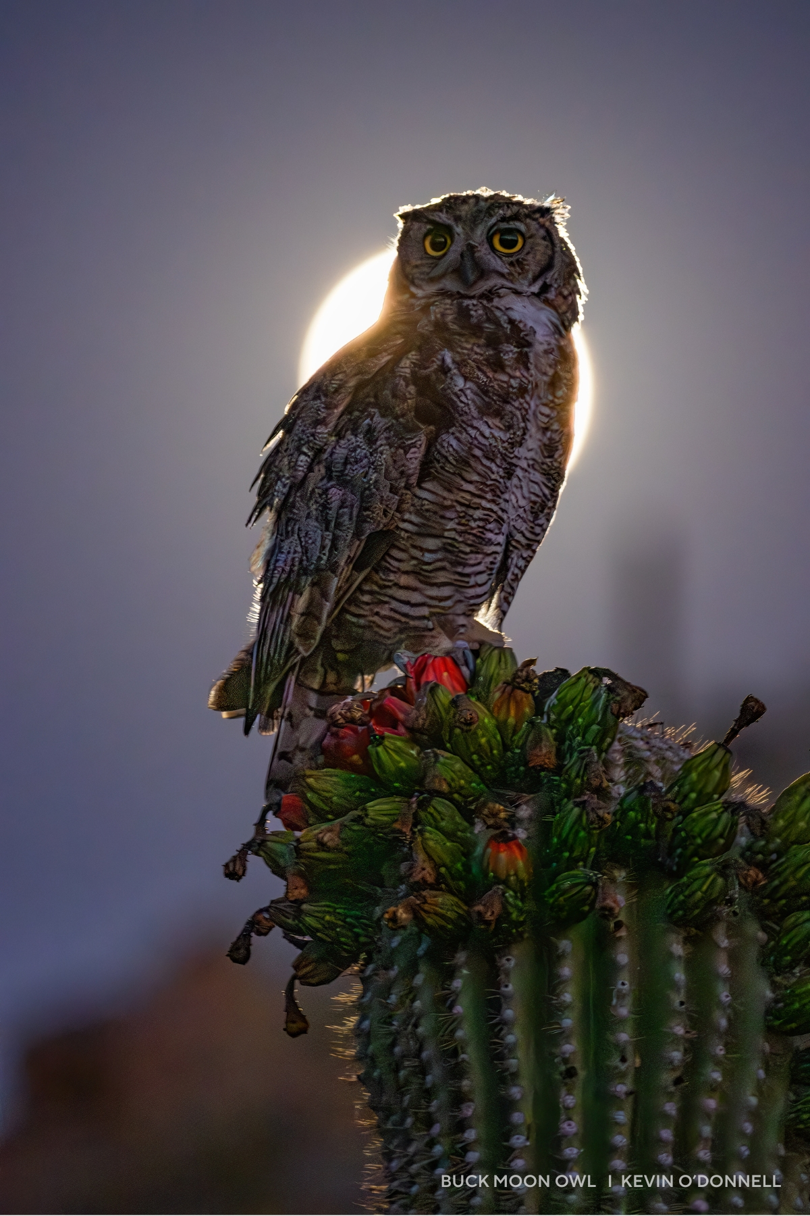


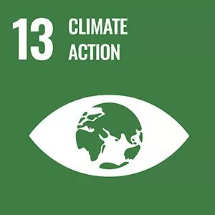


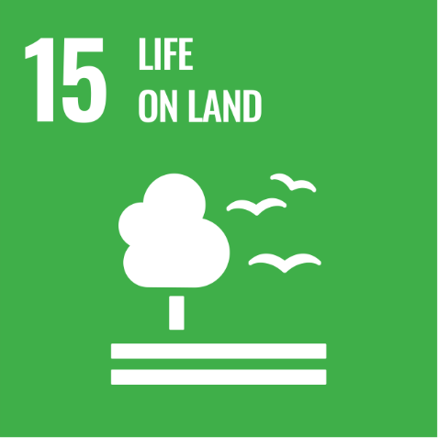
Purpose/Approach
Main Goal: Create Lighting Guide
Compile information/research on nature friendly lighting solutions that maintain human safety
Propose draft for town regulations to better match project research findings
Notes:
Alex
Bullet 1: as a reference for residents and businesses in Durham to pursue nature-friendly, cost-effective, andsustainable lighting solutions

Slide 5
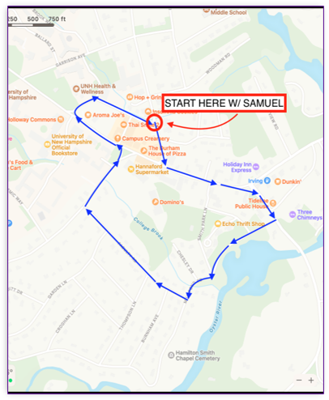
Methods
Researched Department of Transportation lighting recommendations for roadways
Reviewed DarkSky’s website to understand how artificial light affects humans and the environment
Met with Sam Hewitt from Durham Public Works Department to ask questions regarding town’s lighting decisions
Weekly meetings with advisor, Paul Rasmussen, to discuss areas in Durham that use light; received his input on project deliverables
Met with Sam
Own Work​
Notes:
Our team employed a variety of methods to conduct our project. We began by researching the Department of Transportation recommendations for roadway lighting, specifically high impact areas such highways and crosswalks.
We then reviewed DarkSky’s website to understand how artificial light at night affects humans and the environment.
From this, we combined recommendations from both the DOT and DarkSky to create an informational lighting guide as Alex mentioned.
For our team field trip, we talked with Sam Hewitt from the Durham Public Works Department to ask him questions regarding the town’s lighting decisions. We met with Sam before sunrise to see how nighttime lighting interacts with the town. You can see on this map, we started on Madbury Rd, then went down Main Street, over by the Mill Pond, and into the residential area by Faculty rd.
Additionally, we conducted weekly meetings with our advisor, Paul, to discuss categorical areas in Durham that use light in different ways and we welcomed his input on our project deliverables.

Slide 6
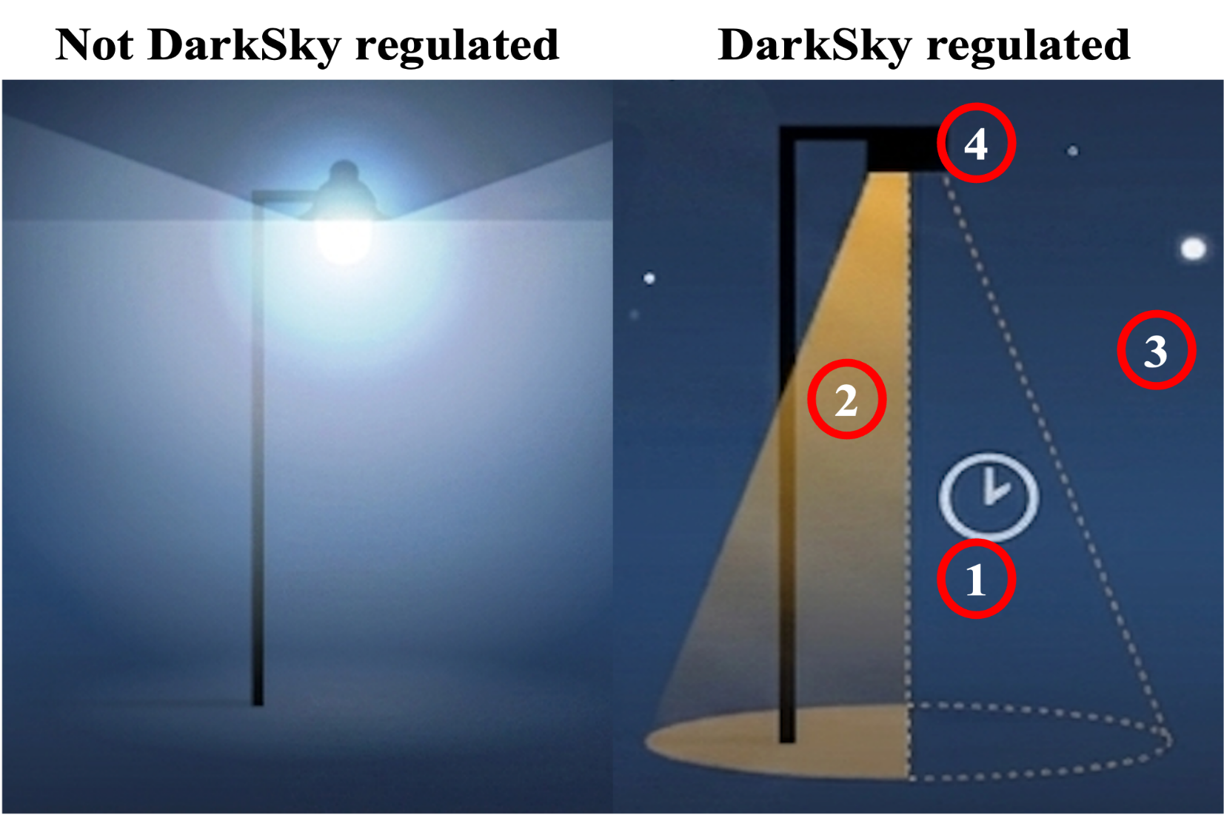
Balancing Security with Ecological Protection
In general, light should be:
Used only when needed.
Shaded towards warm colors
No brighter than necessary
Directed whenever possible
Not DarkSky Regulated
DarkSky Regulated
https://bigbendsentinel.com/2022/01/12/presidio-leads-the-pack-among-big-bend-communities-implementing-dark-sky-lighting-ordinances/
Notes:
1. Timers and sensors reduce light pollution and protect nocturnal wildlife
2 . Warm-toned, long-wavelength LEDs minimize biodiversity loss and environmental disruptions.
Lessen light intensity to stop “sky glow”, protect migratory species, and reduce ecological impact. Shield and direct light downward to prevent light trespass and protect nocturnal habitats
3.

Slide 7
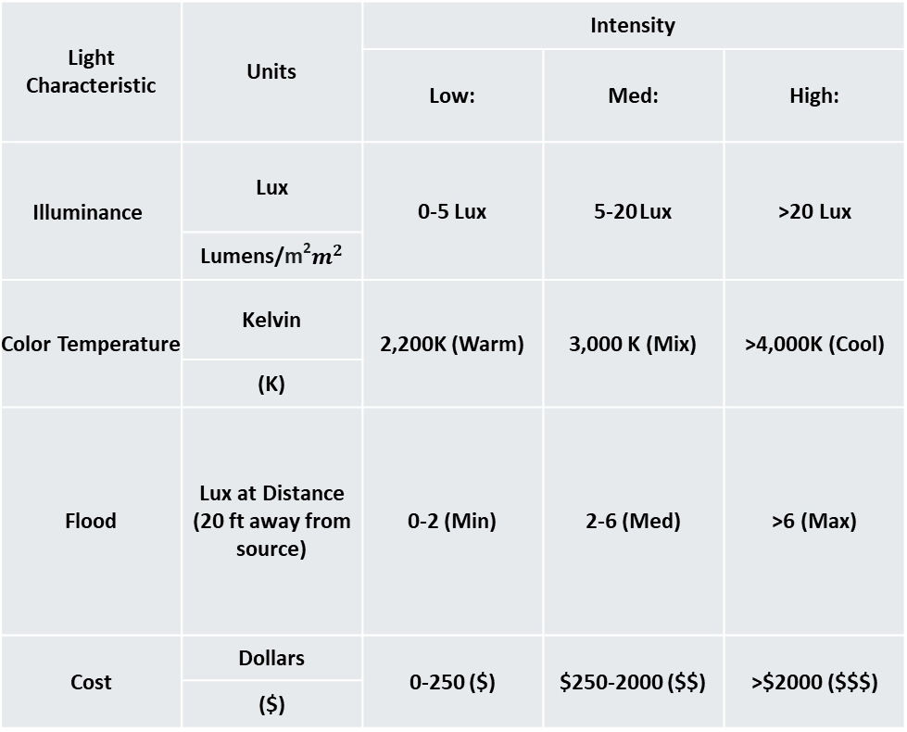
Light Performance Metrics
Illuminance
  Measurement of how much light reaches the intended surface
Color Temperature
  Measurement of the visual tint and color of the light glow
Flood
  The horizontal spread of light over a large area
Cost
  Cost estimate for initial purchase and installation of fixtures
Light Characteristic | Units | Intensity
 |  | Low: | Med: | High:
Illuminance | Lux | 0-5 Lux | 5-20 Lux | >20 Lux
 | Lumens/m²$m^{2}$
Color Temperature | Kelvin | 2,200K (Warm) | 3,000 K (Mix) | >4,000K (Cool)
 | (K)
Flood | Lux at Distance (20 ft away from source) | 0-2 (Min) | 2-6 (Med) | >6 (Max)
Cost | Dollars | 0-250 ($) | $250-2000 ($$) | >$2000 ($$$)
 | ($)
Notes:
Lumen = a unit of measurement for the total amount of visible light emitted by a source
Cost estimate does not include operations of the fixture, only purchase and installation.

Slide 8
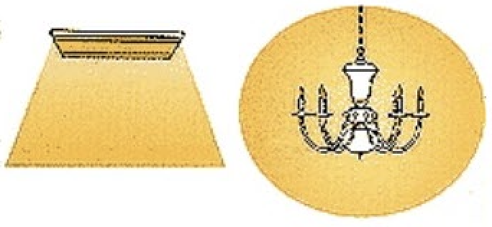
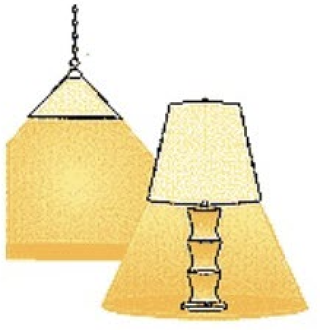
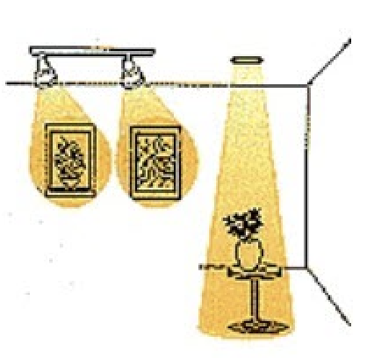
Categories of Lighting
Ambient
Provides general illumination to a space
Task
Focused on specific areas or particular tasks
Accent
Draws attention to objects or features
Illumination: 5 -20 Lux
(Medium)
Color Temp: ~ 3000 K (Medium)
Flood: 2-6 Lux
(Medium)
Cost: $150 - $1500
Illumination: >20 Lux
(High)
Color Temp: 3000K - 4000K (High)
Flood: < 4 Lux
(Low)
Cost: $100 - $300
Illumination: 0-5 Lux
(Low)
Color Temp: 2200K - 3000 K (Low)
Flood: < 4 Lux
(Low)
Cost: $120 - $400
https://shopeverbright.com/blogs/news/how-to-choose-3-basic-types-of-lighting
Notes:
Hayden

Slide 9
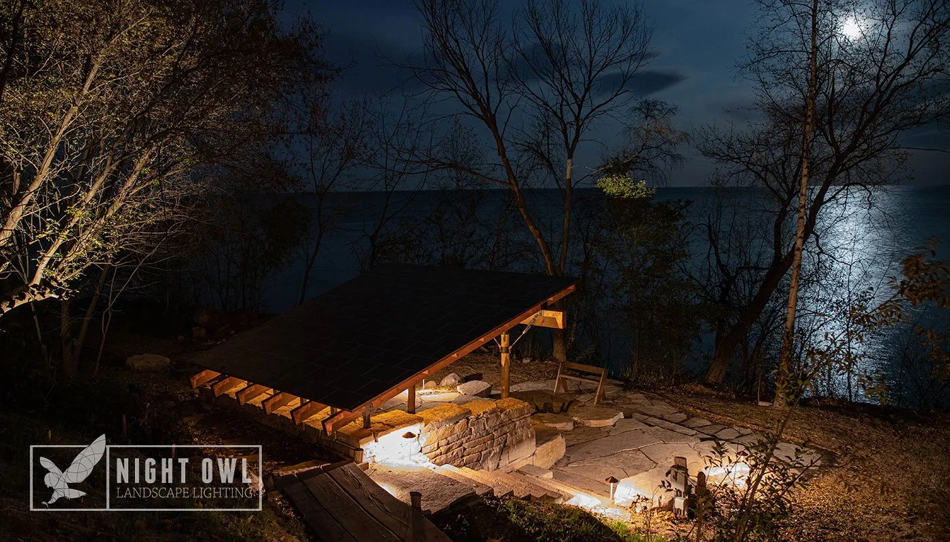
Ambient
Natural night sky unaffected
Downward light Minimizes flood out of patio
Stone reflects some light to help illuminate surroundings
Notes:
Stone reflects 10-20% of light shining on it

Slide 10
Task
Targeted illumination for outdoor tasks
Stairs are illuminated for safety
Notes:
Outdoor tasks include: dri

Slide 11
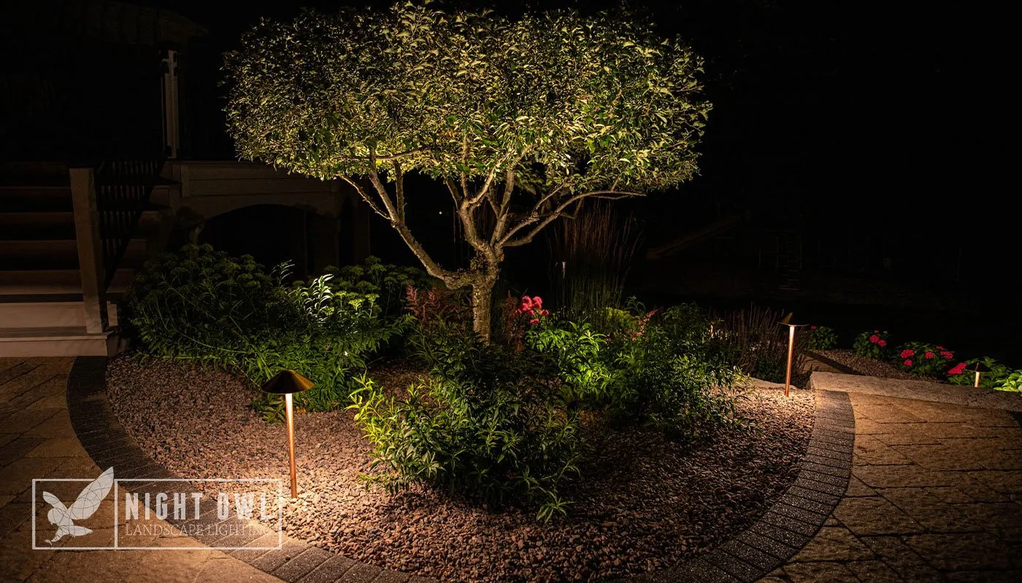
Accent
Light focused on focal garden feature
Subtly highlight low lying greenery
Light does not shine past intended area

Slide 12
Property Type
Residential
Commercial
Ecological
Notes:
Cost only includes fixture itself, not installation or operation. Can be difficult to categorize cost since it depends on customer’s preference and what scenario they need lighting for, typically commercial is more expensive than residential

Slide 13
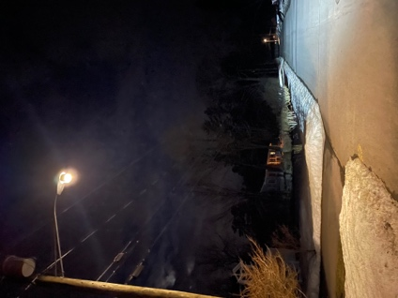
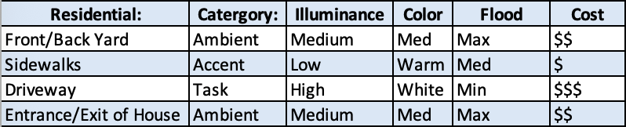

Residential
Personal security and basic navigation.
Avoid trespass into neighboring properties and the environment.
Notes:
Using the principles of nature friendliness, performance metrics, and categories, we have developed a lighting guide to inform choices for outdoor lighting in the community.
We make specific recommendations based off the uses of lighting, along with the relative price of these fixtures.
Lighting in residential areas should focus personal security/basic nav.
Lighting of key areas rather than general illumination of entire properties.
This avoids spreading light outside of the intended area, avoids trespass for neighbors and the environment.
Lighting in commercial areas should focus on safety and visibility.
Provide a comfortable, inviting atmosphere.
Conform to applicable safety regulations.
Reducing glare and wasted light/energy (skyglow).
Ecological prioritizes protection of important natural areas.
Warm or amber lighting is prioritized, and shielding lights to prevent light from impacting natural areas.
Focuses on reducing light using timers and motion sensors.

Slide 14
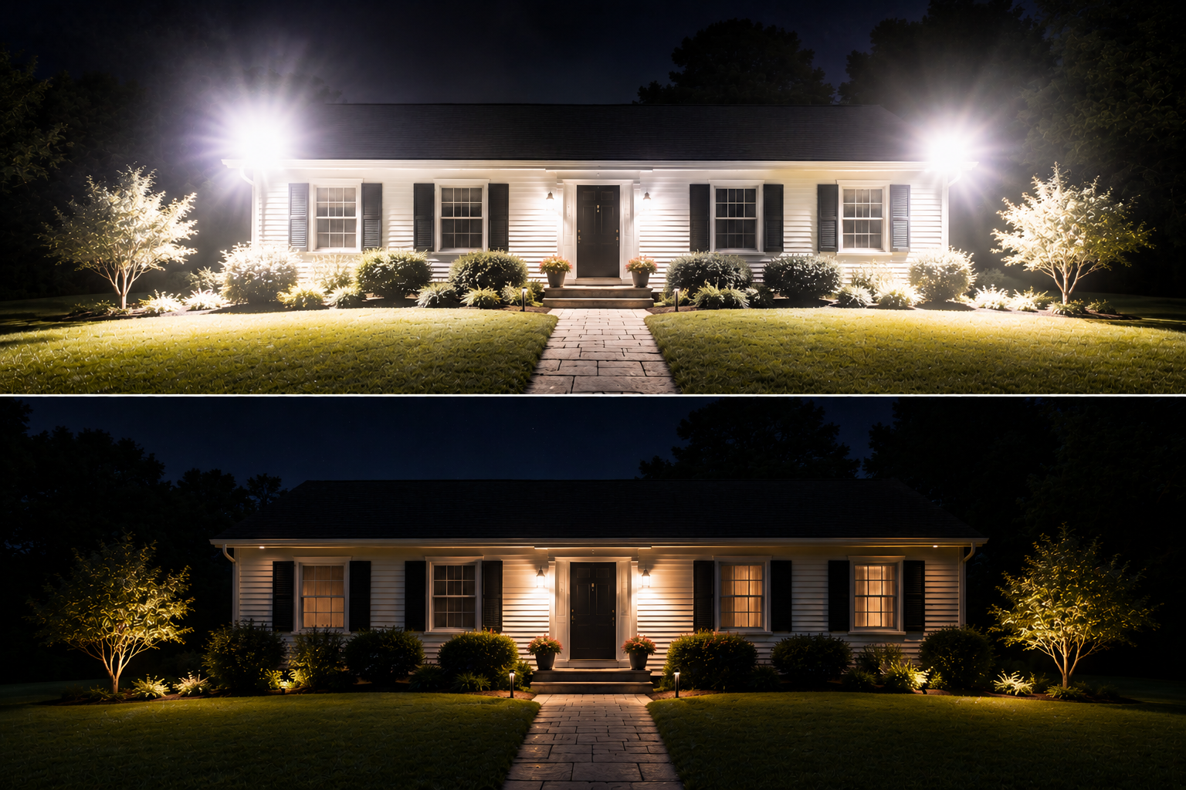
Residential
Ambient
Accent
Task
Notes:
Using the principles of nature friendliness, performance metrics, and categories, we have developed a lighting guide to inform choices for outdoor lighting in the community.
We make specific recommendations based off the uses of lighting, along with the relative price of these fixtures.
Lighting in residential areas should focus personal security/basic nav.
Lighting of key areas rather than general illumination of entire properties.
This avoids spreading light outside of the intended area, avoids trespass for neighbors and the environment.
Lighting in commercial areas should focus on safety and visibility.
Provide a comfortable, inviting atmosphere.
Conform to applicable safety regulations.
Reducing glare and wasted light/energy (skyglow).
Ecological prioritizes protection of important natural areas.
Warm or amber lighting is prioritized, and shielding lights to prevent light from impacting natural areas.
Focuses on reducing light using timers and motion sensors.

Slide 15
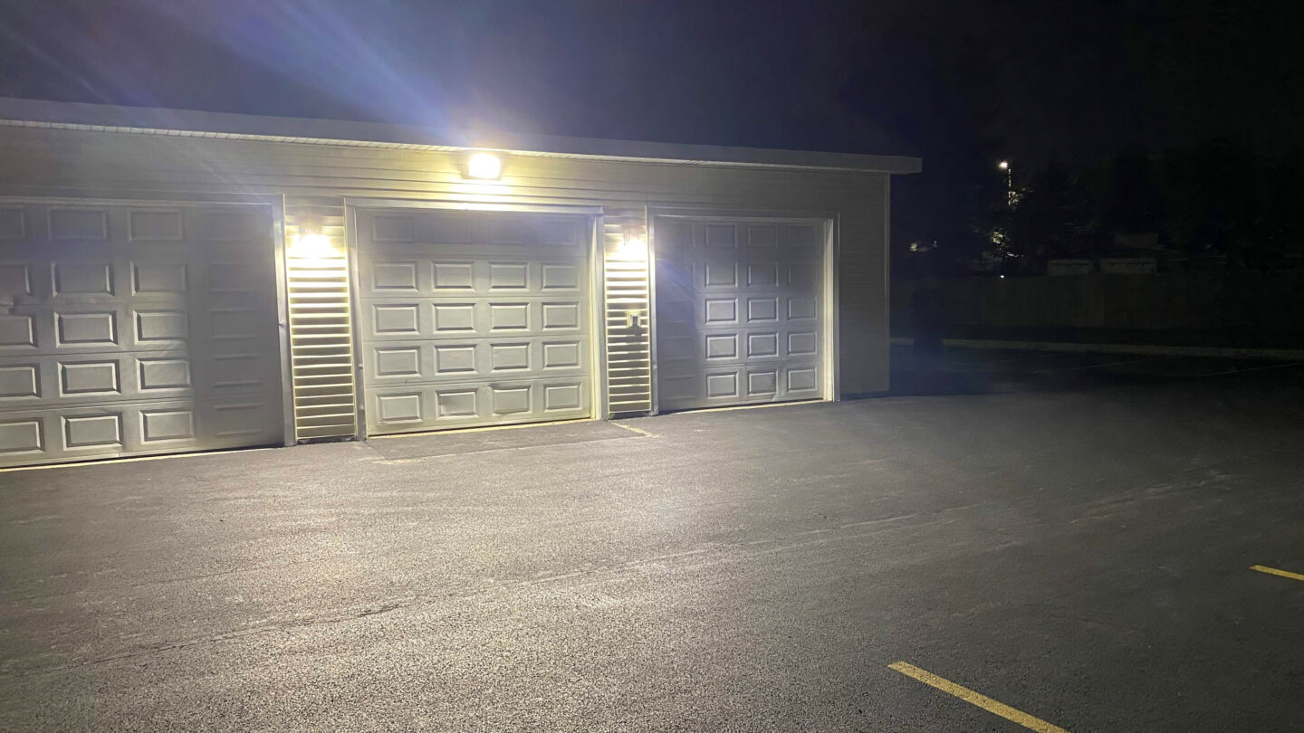
Brighter ≠ More Safe

Slide 16
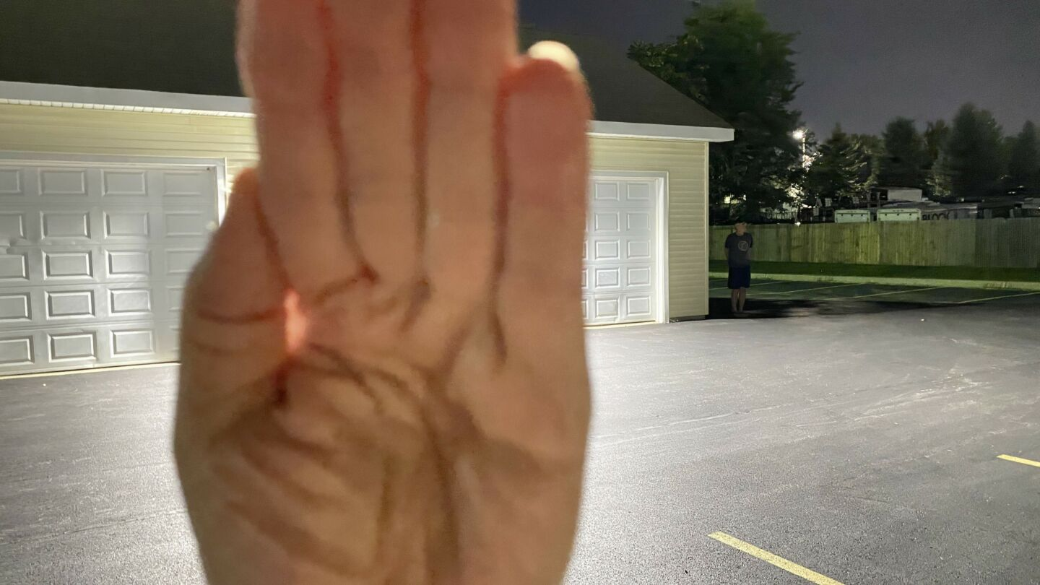
Brighter ≠ More Safe

Slide 17
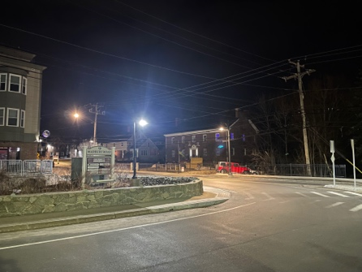
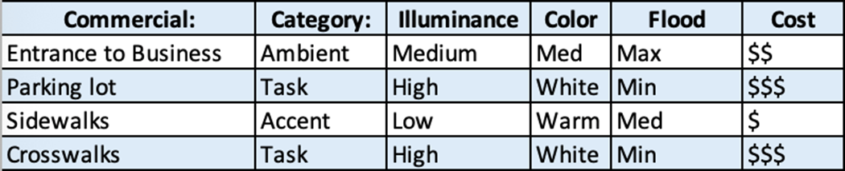
Commercial
Public safety, comfort, and visibility.
Reduce glare and sky glow.
Notes:
Using the principles of nature friendliness, performance metrics, and categories, we have developed a lighting guide to inform choices for outdoor lighting in the community.
We make specific recommendations based off the uses of lighting, along with the relative price of these fixtures.
Lighting in residential areas should focus personal security/basic nav.
Lighting of key areas rather than general illumination of entire properties.
This avoids spreading light outside of the intended area, avoids trespass for neighbors and the environment.
Lighting in commercial areas should focus on safety and visibility.
Provide a comfortable, inviting atmosphere.
Conform to applicable safety regulations.
Reducing glare and wasted light/energy (skyglow).
Ecological prioritizes protection of important natural areas.
Warm or amber lighting is prioritized, and shielding lights to prevent light from impacting natural areas.
Focuses on reducing light using timers and motion sensors.

Slide 18
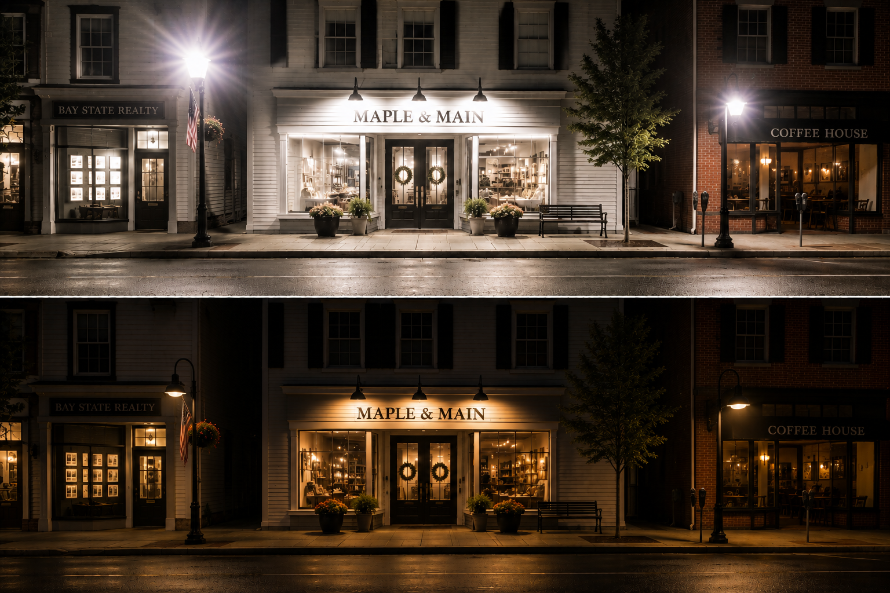
Commercial
Accent
Ambient
Notes:
Using the principles of nature friendliness, performance metrics, and categories, we have developed a lighting guide to inform choices for outdoor lighting in the community.
We make specific recommendations based off the uses of lighting, along with the relative price of these fixtures.
Lighting in residential areas should focus personal security/basic nav.
Lighting of key areas rather than general illumination of entire properties.
This avoids spreading light outside of the intended area, avoids trespass for neighbors and the environment.
Lighting in commercial areas should focus on safety and visibility.
Provide a comfortable, inviting atmosphere.
Conform to applicable safety regulations.
Reducing glare and wasted light/energy (skyglow).
Ecological prioritizes protection of important natural areas.
Warm or amber lighting is prioritized, and shielding lights to prevent light from impacting natural areas.
Focuses on reducing light using timers and motion sensors.

Slide 19
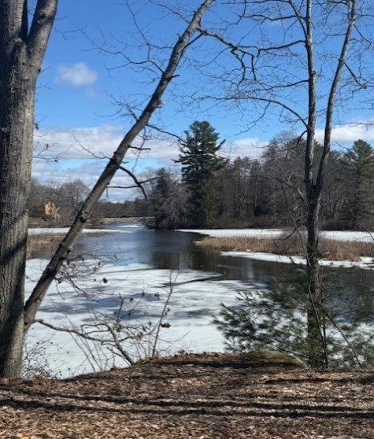
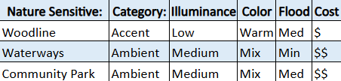
Ecological
Warm colors and shielding.
Timers and motion sensors.
Notes:
Using the principles of nature friendliness, performance metrics, and categories, we have developed a lighting guide to inform choices for outdoor lighting in the community.
We make specific recommendations based off the uses of lighting, along with the relative price of these fixtures.
Lighting in residential areas should focus personal security/basic nav.
Lighting of key areas rather than general illumination of entire properties.
This avoids spreading light outside of the intended area, avoids trespass for neighbors and the environment.
Lighting in commercial areas should focus on safety and visibility.
Provide a comfortable, inviting atmosphere.
Conform to applicable safety regulations.
Reducing glare and wasted light/energy (skyglow).
Ecological prioritizes protection of important natural areas.
Warm or amber lighting is prioritized, and shielding lights to prevent light from impacting natural areas.
Focuses on reducing light using timers and motion sensors.

Slide 20
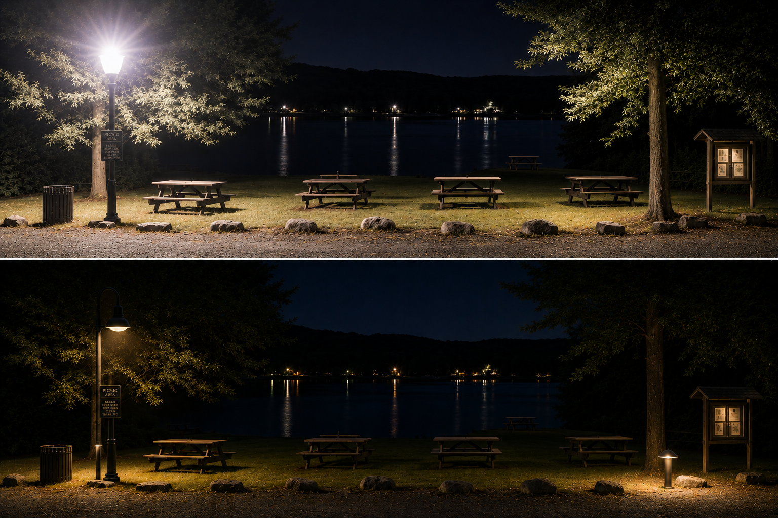
Ecological
Ambient
Task
Notes:
Using the principles of nature friendliness, performance metrics, and categories, we have developed a lighting guide to inform choices for outdoor lighting in the community.
We make specific recommendations based off the uses of lighting, along with the relative price of these fixtures.
Lighting in residential areas should focus personal security/basic nav.
Lighting of key areas rather than general illumination of entire properties.
This avoids spreading light outside of the intended area, avoids trespass for neighbors and the environment.
Lighting in commercial areas should focus on safety and visibility.
Provide a comfortable, inviting atmosphere.
Conform to applicable safety regulations.
Reducing glare and wasted light/energy (skyglow).
Ecological prioritizes protection of important natural areas.
Warm or amber lighting is prioritized, and shielding lights to prevent light from impacting natural areas.
Focuses on reducing light using timers and motion sensors.

Slide 21
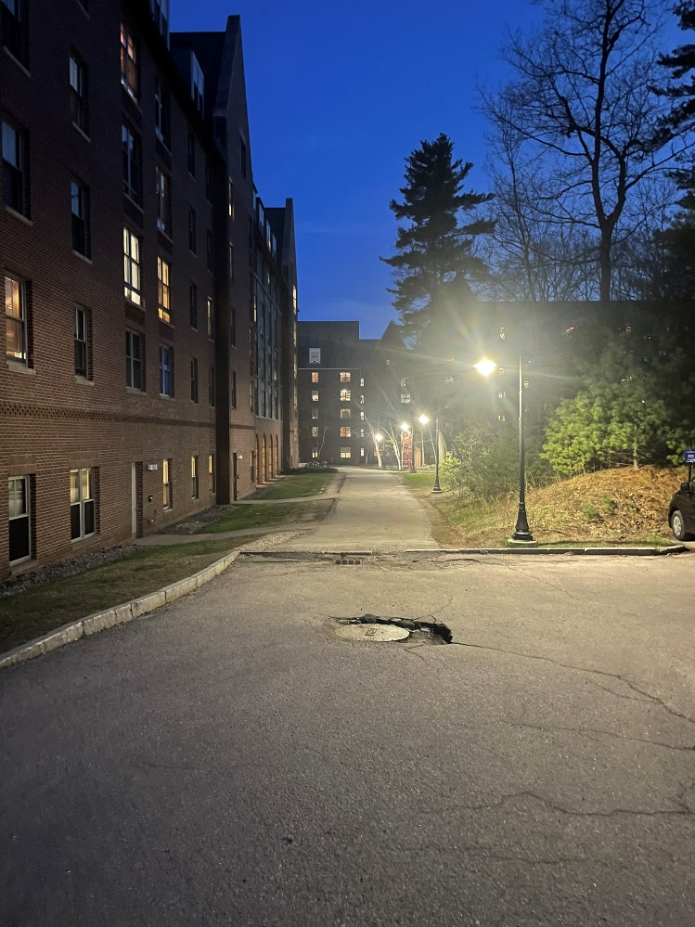
Considerations for Planning Board
Site plan regulations:
  Update language.
  Trespass into natural areas.
  Color temperature.
Maximum lumens/acre and color temperature into zoning ordinance.

Slide 22
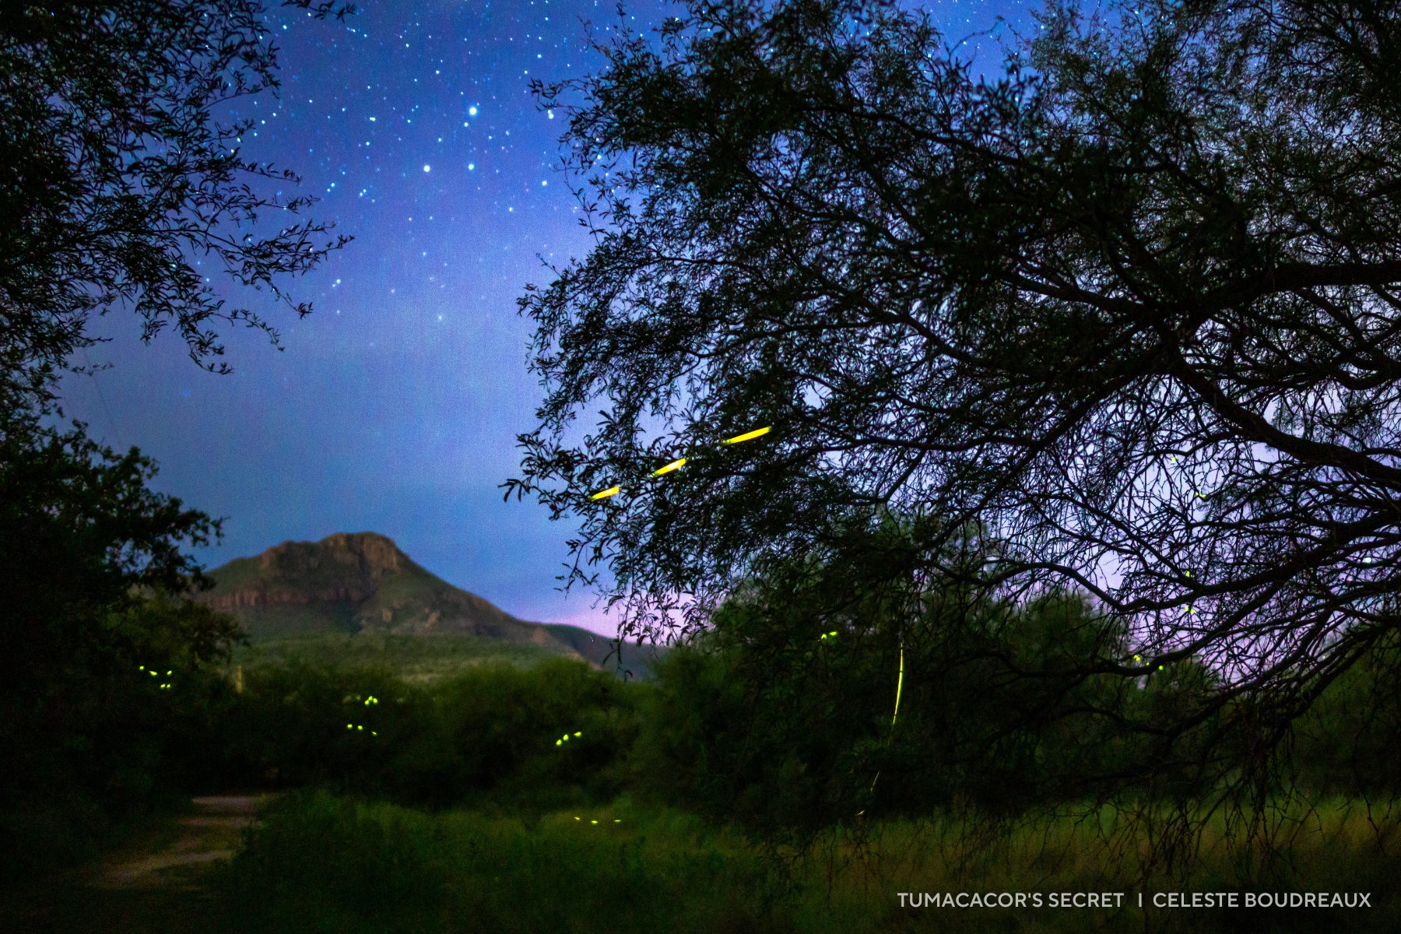
Discussion/Future Work
Recommendations apply in many different places
More study/outreach to encourage adoption of these principles
Planning Board can refer to lighting guide during site plan and zoning reviews → stay within maximum lighting characteristics
Notes:
Will
While we make recommendations specific to the town of Durham in the guide, the principles can be applied anywhere.
Now that we have developed these recommendations, we hope that work can continue to encourage adoption of these principles.
Planning Board can refer to lighting guide during site plan and zoning reviews to ensure the developer stays within maximum lighting characteristics recommended in the guide. This is especially important when building around nature-sensitive areas, such as rivers or woodlines.

Slide 23
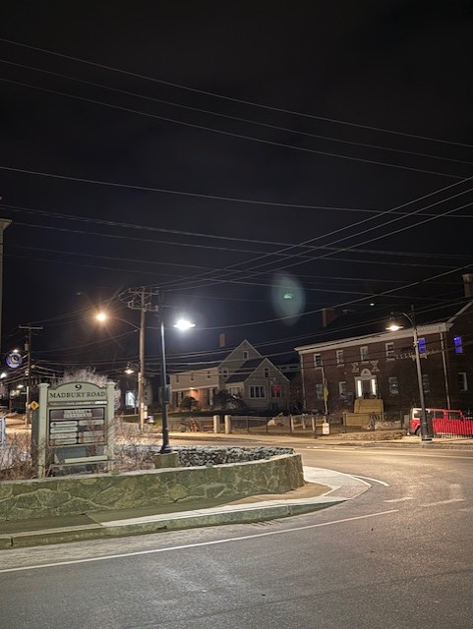
Conclusions
Research indicates that nature friendliness and human safety can work in harmony when making lighting decisions.
Artificial/natural lighting and the value it provides us is often taken for granted in society
Getting our research into as many hands and in front of as many eyes as possible will be pivotal to its sustainability impact
Notes:
Alex

Slide 24
Acknowledgements
Paul Rasmussen for proposing this project, supporting us through weekly meetings and sharing his meaningful insight into lighting techniques
Samuel Hewitt for taking the time to answer our questions regarding the town’s decision for lighting strategies
Todd Selig for reviewing our lighting guide draft and providing feedback
Durham Planning Board for welcoming us and listening to this presentation
Notes:
Alex

Slide 25
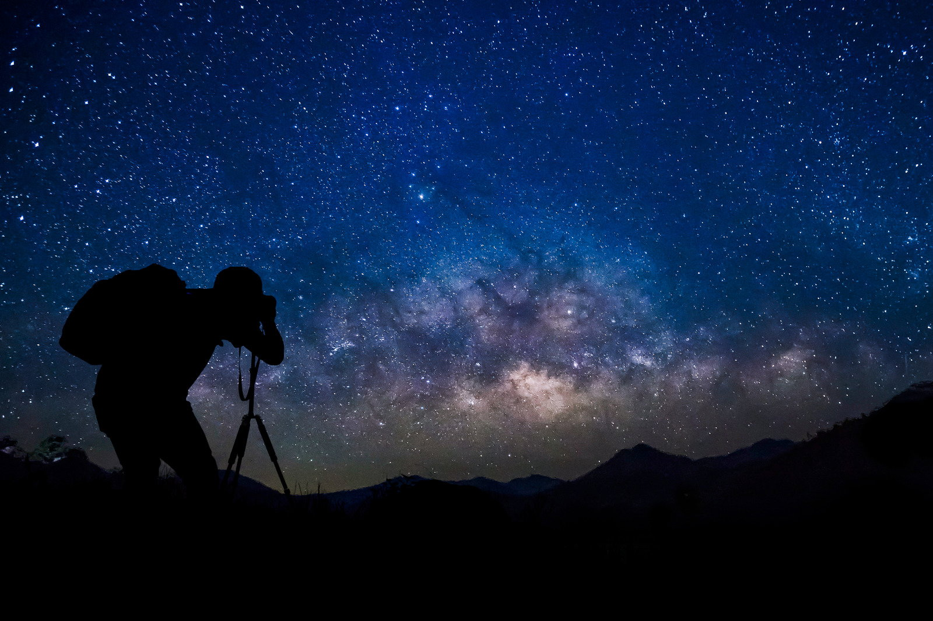
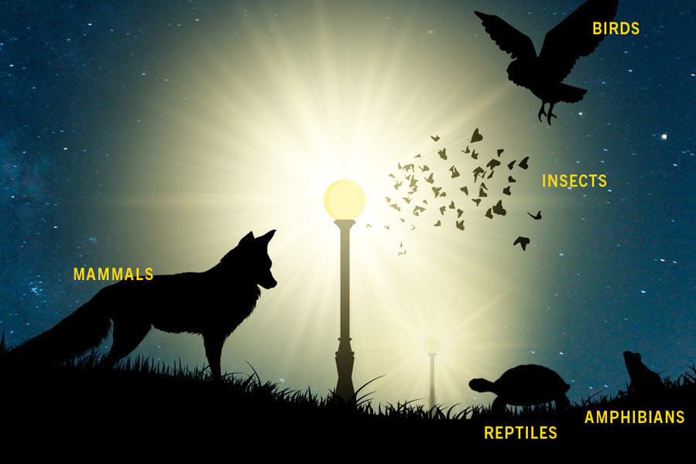
Thank you for listening!
Source: Blog: Tips on Observing the Night Sky - TRACKS Youth Program
Source: Light Pollution Harms Wildlife Light Is Energy: Estimating The Impact
Notes:
Alex
We will be happy to answer questions.

