Slide 1
Proposed Updates to Durham NH Site Planning Documents: Integrating EV Charging Requirements
Enhancing sustainability through updated planning guidelines
Notes:
AI-generated content may be incorrect. --- This presentation outlines proposed updates to Durham, NH's site planning documents focused on integrating electric vehicle (EV) charging requirements to support sustainability and community growth.

Slide 2
Agenda Overview
Durham Energy Committee: Motivation for Change
Details of the Proposed EV Charging Requirements
Case Reviews: Situations Requiring EV Charging
Implications for Stakeholders
Notes:
We will review the current site planning framework in Durham, explore motivations behind the proposed EV charging updates, detail the new requirements, examine case examples, and discuss implications for all stakeholders involved.

Slide 3
Durham Energy Committee: Motivation for Change
Notes:
The Durham Energy Committee drives sustainability initiatives by aligning local policies with environmental priorities. Their motivation for integrating EV charging is rooted in advancing clean transportation and reducing carbon emissions.

Slide 4
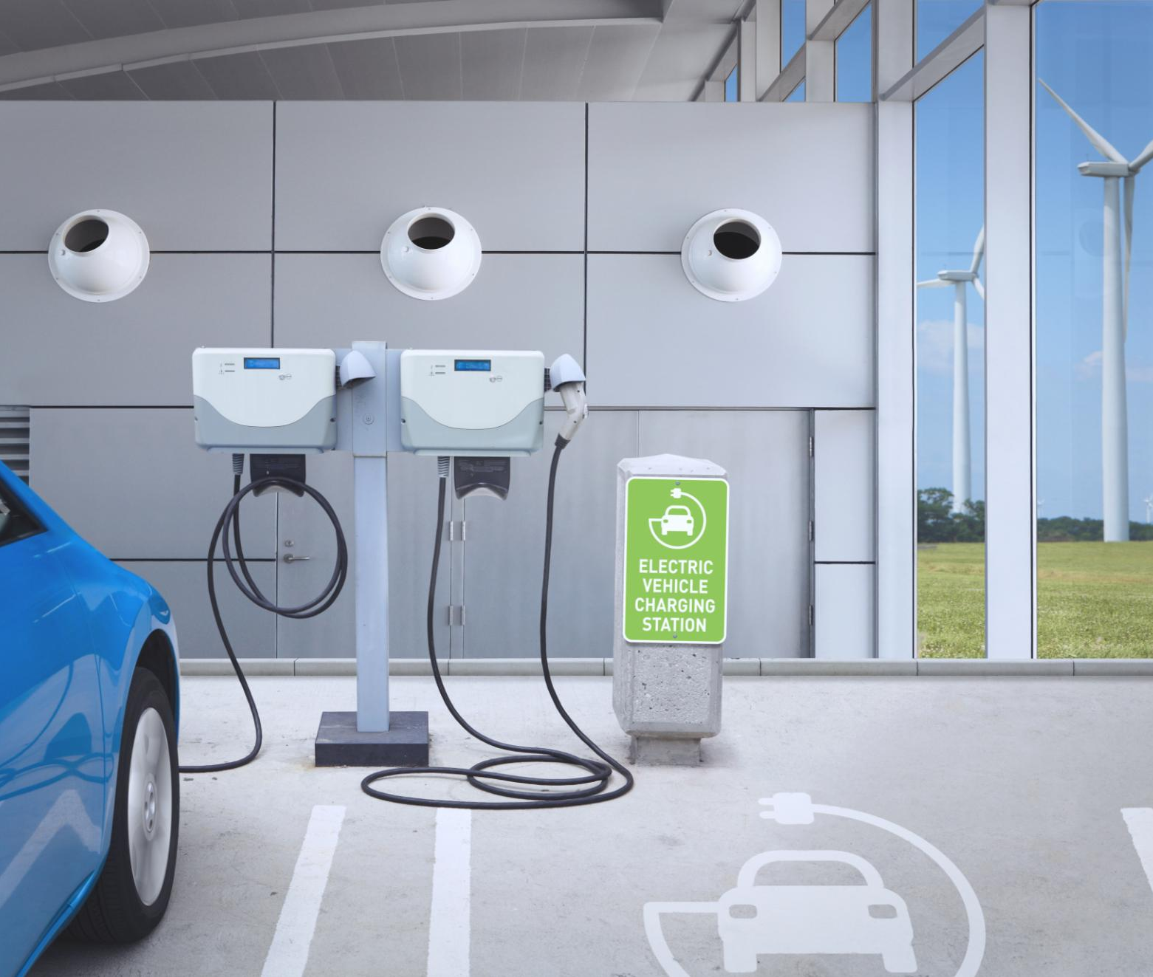
Committee’s Goals
Goal 1: Assist Durham in achieving the Climate Action Plan goal of providing renewable energy options through Community Power, including a 100% renewable energy option.
Goal 2: Explore and provide education regarding other sources of renewable and “Green” electric power.
Goal 3: Improve energy efficiency and reduction of the carbon footprint of existing residential and commercial buildings in Durham.
Goal 4: Support EV ownership through Education & Infrastructure Installation
Goal 5: Improve and expand Community Outreach and Education to achieve Durham Climate Action Plan goals.
Energy Committee created in 2007 to advise Durham on its energy goals and support the Climate Action Plan (CAP)
Notes:
--- The committee aims to foster energy efficiency, reduce greenhouse gas emissions, and promote renewable energy adoption. Incorporating EV infrastructure supports these goals by facilitating cleaner vehicle use. Image source: Microsoft 365 content library

Slide 5
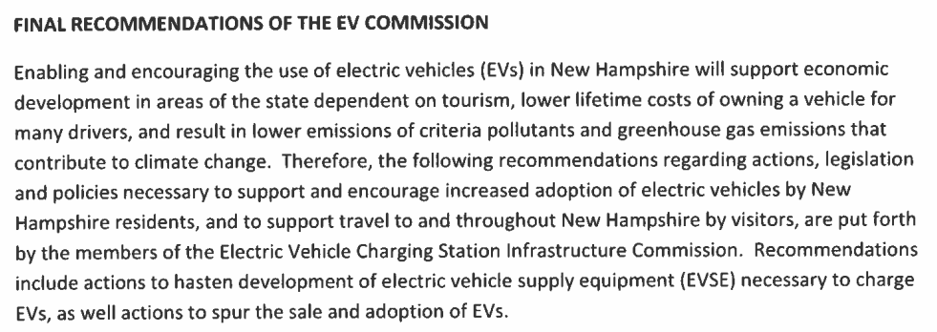




NH State Recommendations
Excerpt from NH Senate memorandum, Nov 9th 2020
referencing SB 517, Chapter 154:1, Laws of 2018
Notes:
SB 517, Chapter 154:1, Laws of 2018

Slide 6
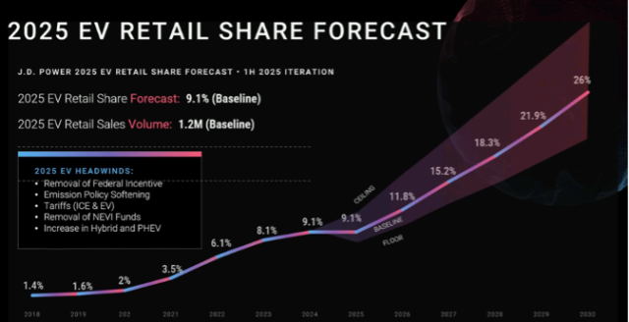
National EV Growth continues
2018 2019 2020 2021 2022 2023 2024 2025 2026 2027 2028 2029 2030
While exact EV growth is unknown, it will continue to rise.

Slide 7
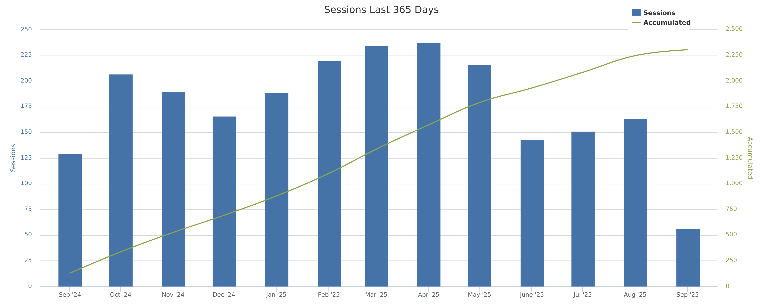
And we see that trend in Durham as well at our town chargers...
Seasonal dip aligned to UNH school year
...Avoiding 35,000kg of Greenhouse Gas Emissions.!!!
Notes:
That is like removing the carbon footprint of a small neighborhood
🌳Equivalent to planting 580 trees
🚗Like removing 7 cars from the road for a year
⛽Saving 14,000 liters of gasoline

Slide 8
Details of the Proposed EV Charging Requirements
Notes:
We will examine which development projects the requirements apply to, the minimum standards for EV infrastructure, and exceptions or conditional cases where modifications might be warranted.

Slide 9


Three types of EV Spots
EV-PREPARED “From Panel to Parking” | EV-READY “Spots are ‘ready to go’” | EV-INSTALLED “Just pull up and charge”
Off-street parking spot | Off-street parking spot | Off-street parking spot
Conduit pathways exist from power panel to parking | Conduit pathways exist from power panel to parking | Conduit pathways exist from power panel to parking
Electrical panel capacity with room for a future installed EV circuit | Electrical panel capacity with dedicated installed EV circuit | Electrical panel capacity with dedicated installed EV circuit
 | Includes required wiring | Includes required wiring
 |  | Includes required EV Supply equipment (aka. The Charger)
Increasing cost from left to right

Slide 10
Applicability highlights
Applies to
Projects that are subject to Durham Site plan review
Upon creation of new parking spots, or resurfacing of a driveway/parking with removal to subsurface
Multi-family, commercial or other nonresidential property
DOES NOT APPLY TO SINGLE FAMILY HOUSEHOLDS

Slide 11
“Make it Real” Situations Requiring EV Charging
Notes:
Examining real-world examples helps clarify when and how EV charging requirements take effect, illustrating their application across different types of Durham developments.

Slide 12
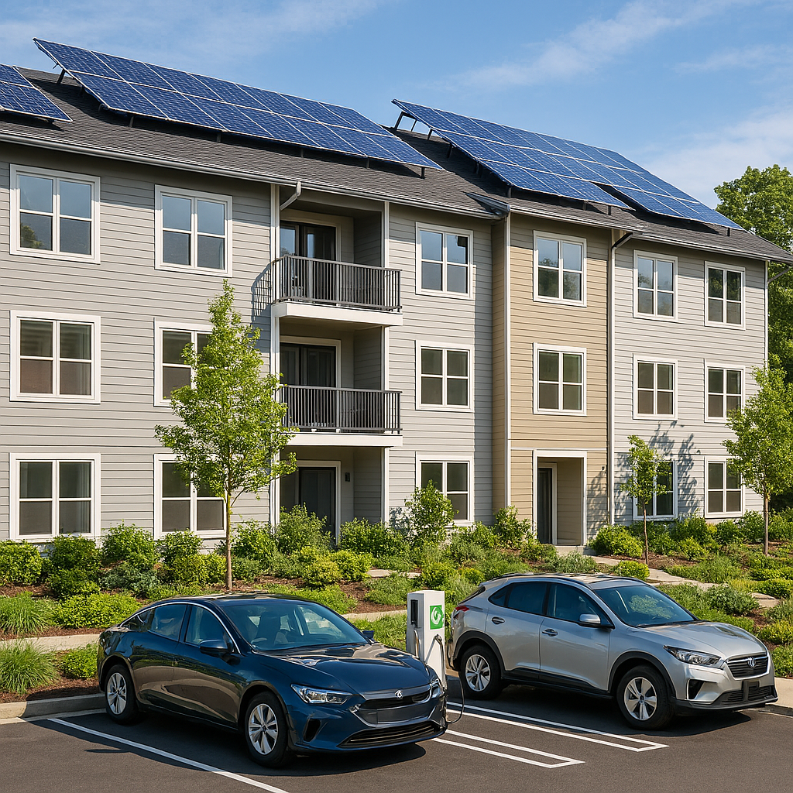
Multi-Family Dwellings
NEW Construction: 5% EV installed; 25% EV-prepared Renovations: 5% EV Installed; 15% EV Prepared
Example:
New Construction (20) Renovations (20) 1 – EV Installed 1 – EV Installed 5 – EV Prepared 3 – EV Prepared
Notes:
--- Commercial projects such as retail centers and office buildings must provide designated EV charging spots to support employees and customers using electric vehicles. Image source: Microsoft 365 content library

Slide 13

Institutional Senior Housing
NEW Construction: 3% EV installed; 25% EV-prepared Renovations: 2% EV Installed; 15% EV Prepared
Example:
New Construction with 100 Renovations with 100 approved spots: approved parking spots: 3 – EV Installed 2 – EV Installed 25 – EV Prepared 15 – EV Prepared
Notes:
--- Commercial projects such as retail centers and office buildings must provide designated EV charging spots to support employees and customers using electric vehicles. Image source: Microsoft 365 content library

Slide 14

Hotels, Motels and Bed & Breakfast Lodging
This Photo by Unknown Author is licensed under CC BY-SA-NC
NEW Construction: 3% EV installed; 25% EV-prepared Renovations: 2% EV Installed; 15% EV Prepared
Example: New Construction with 10 Renovations with 10 approved spots: approved parking spots: 1 – EV Installed 1 – EV Installed 3 – EV Prepared 2 – EV Prepared
Notes:
--- Commercial projects such as retail centers and office buildings must provide designated EV charging spots to support employees and customers using electric vehicles. Image source: Microsoft 365 content library

Slide 15
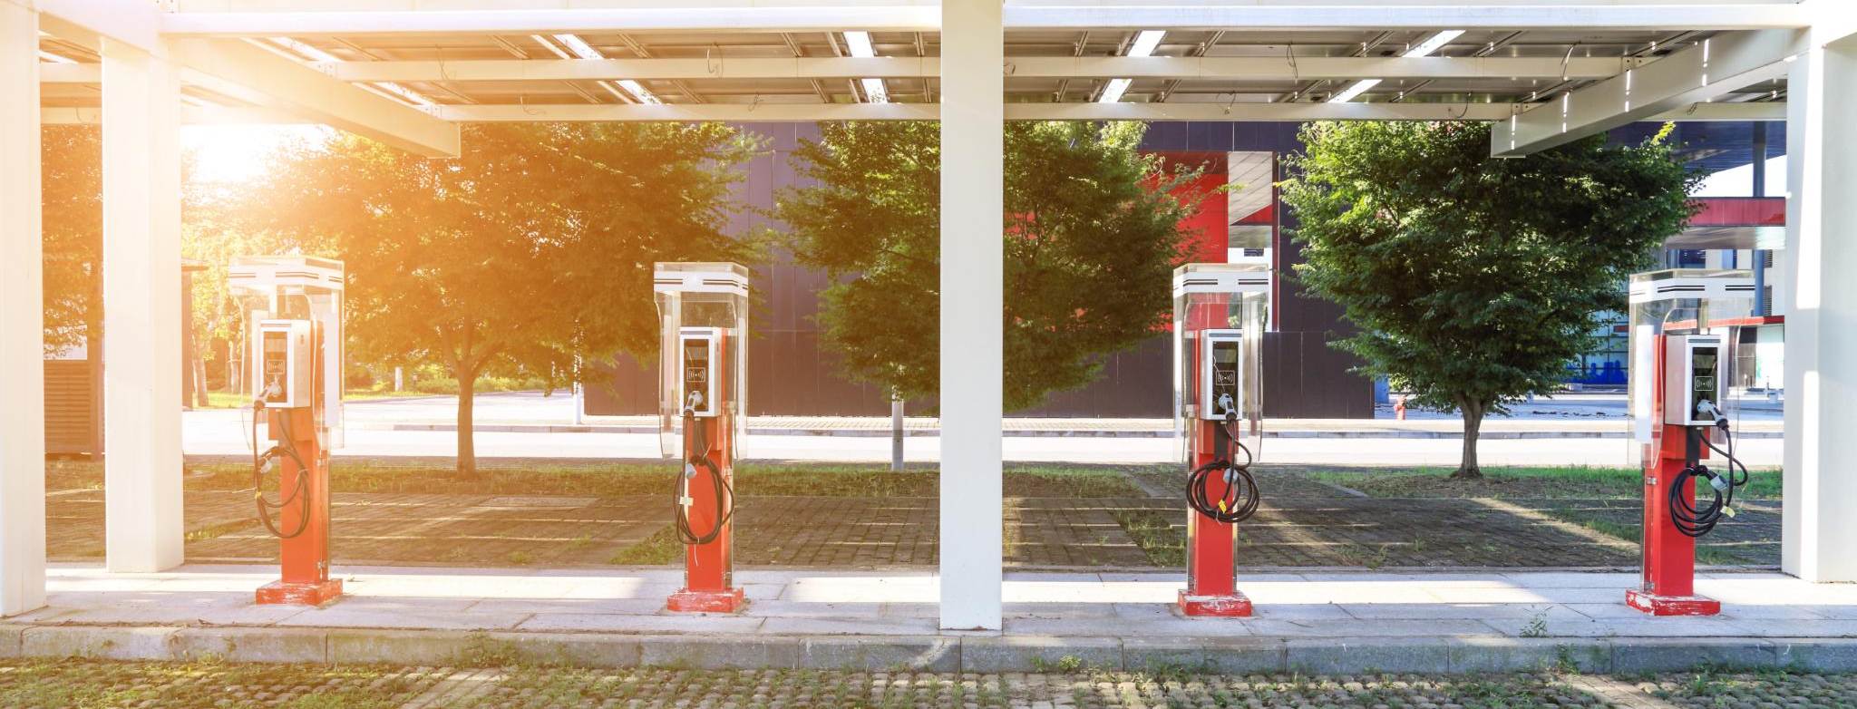
Commercial Construction
NEW Construction: 3% EV installed; 25% EV-prepared Renovations: 2% EV Installed; 15% EV Prepared
Example:
New Construction with 150 Renovations with 150 approved spots approved parking spots: 5 – EV Installed 3 – EV Installed 38 – EV Prepared 23 – EV Prepared
Notes:
--- Commercial projects such as retail centers and office buildings must provide designated EV charging spots to support employees and customers using electric vehicles. Image source: Microsoft 365 content library

Slide 16
Implications for Stakeholders
Notes:
We will discuss how these updates impact developers, residents, businesses, and the long-term economic and environmental outlook for Durham.

Slide 17
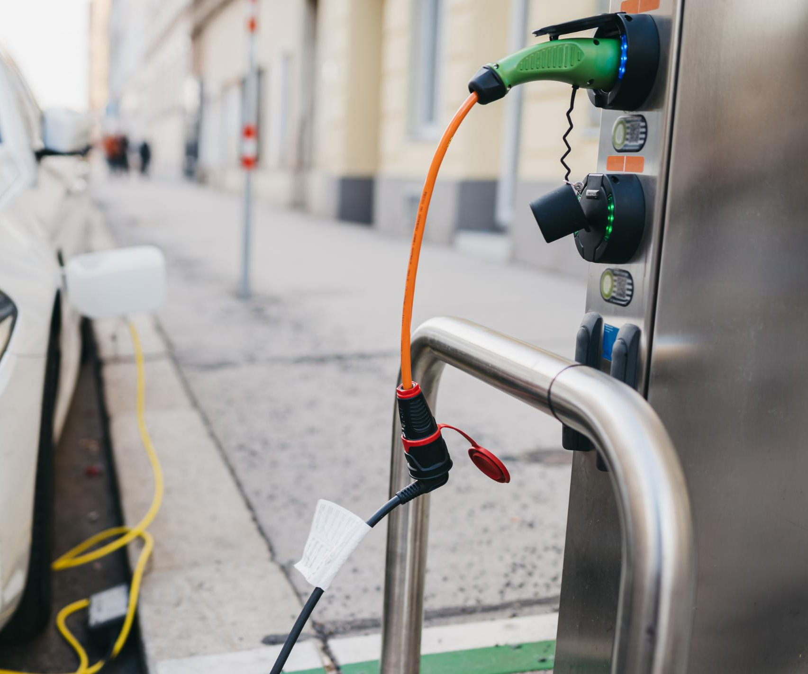
Developers and Builders
Incorporating EV Infrastructure
Developers must integrate electric vehicle charging facilities into new project plans to meet future demands.
Increased Upfront Costs
Adding EV infrastructure may raise initial project expenses but enhances long-term development value.
Future-Proofing Developments
Including EV facilities future-proofs developments, making them more attractive and sustainable.
Notes:
--- Developers will need to incorporate EV infrastructure into project plans, potentially increasing upfront costs but adding value and future-proofing developments. Image source: Microsoft 365 content library

Slide 18
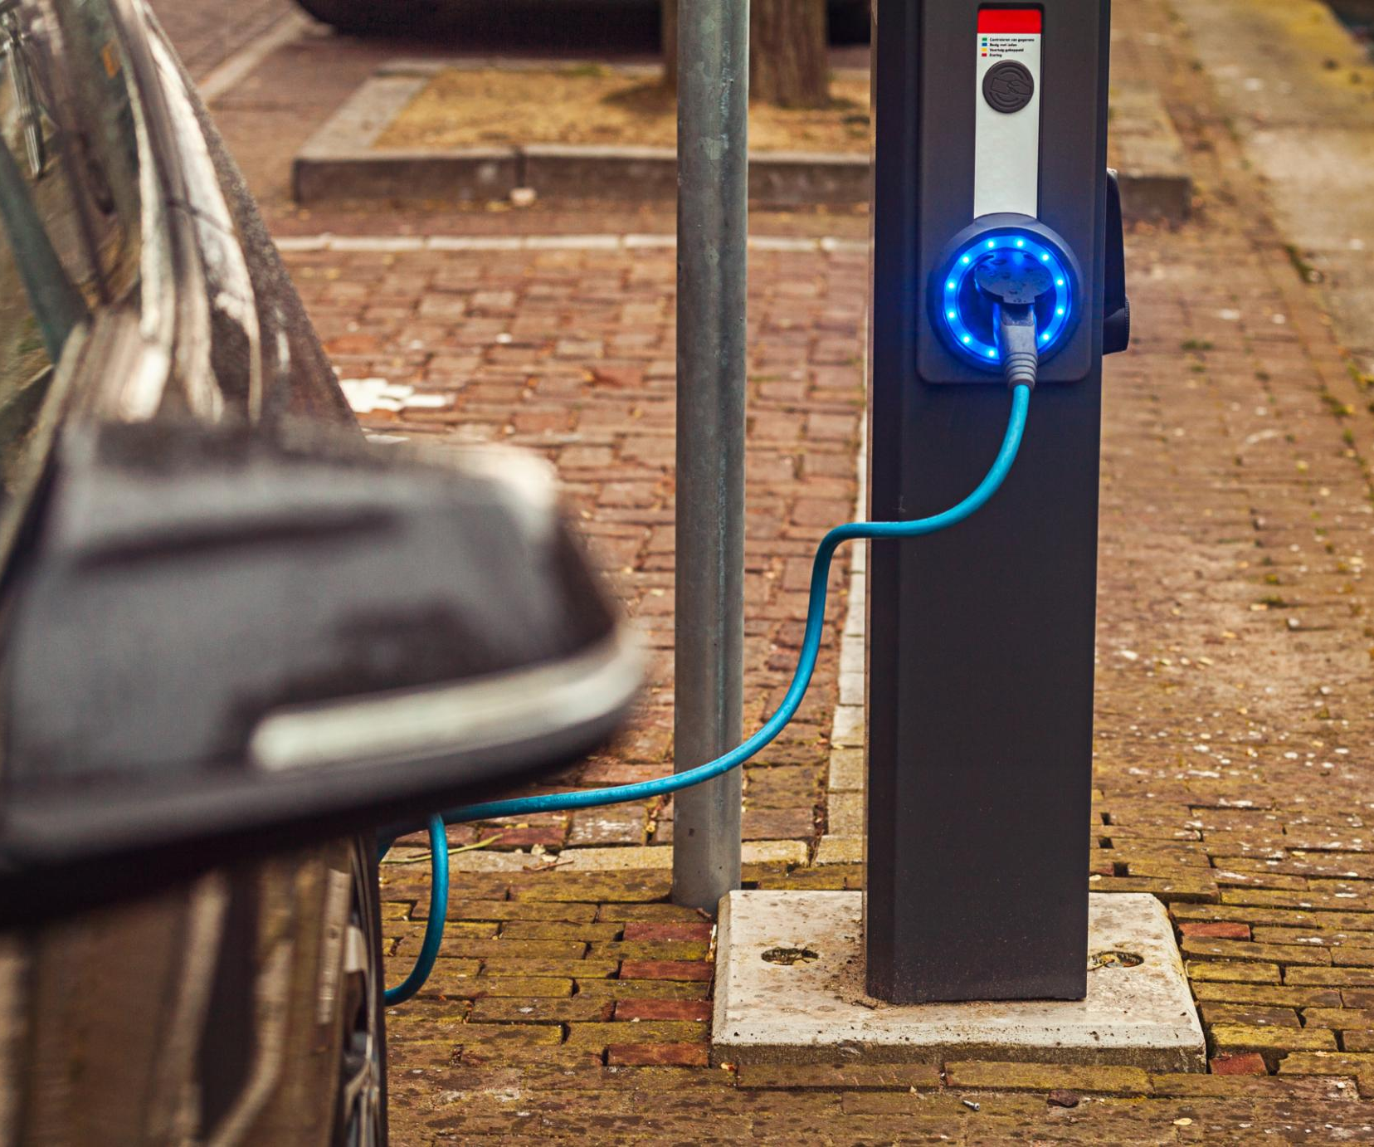
Town Residents and Businesses
Improved EV Charging Access
Enhanced EV charging facilities provide convenient options for residents and businesses to power their vehicles locally.
Cleaner Air Benefits
EV charging supports the reduction of air pollution, promoting healthier living environments for communities, and supports Durhams Climate Action Plan
Green Community Identity
Widespread EV charging helps foster a community image centered on sustainability and environmental responsibility.
Notes:
--- Residents and businesses benefit from improved access to EV charging, supporting cleaner air and fostering a green community identity. Image source: Microsoft 365 content library

Slide 19
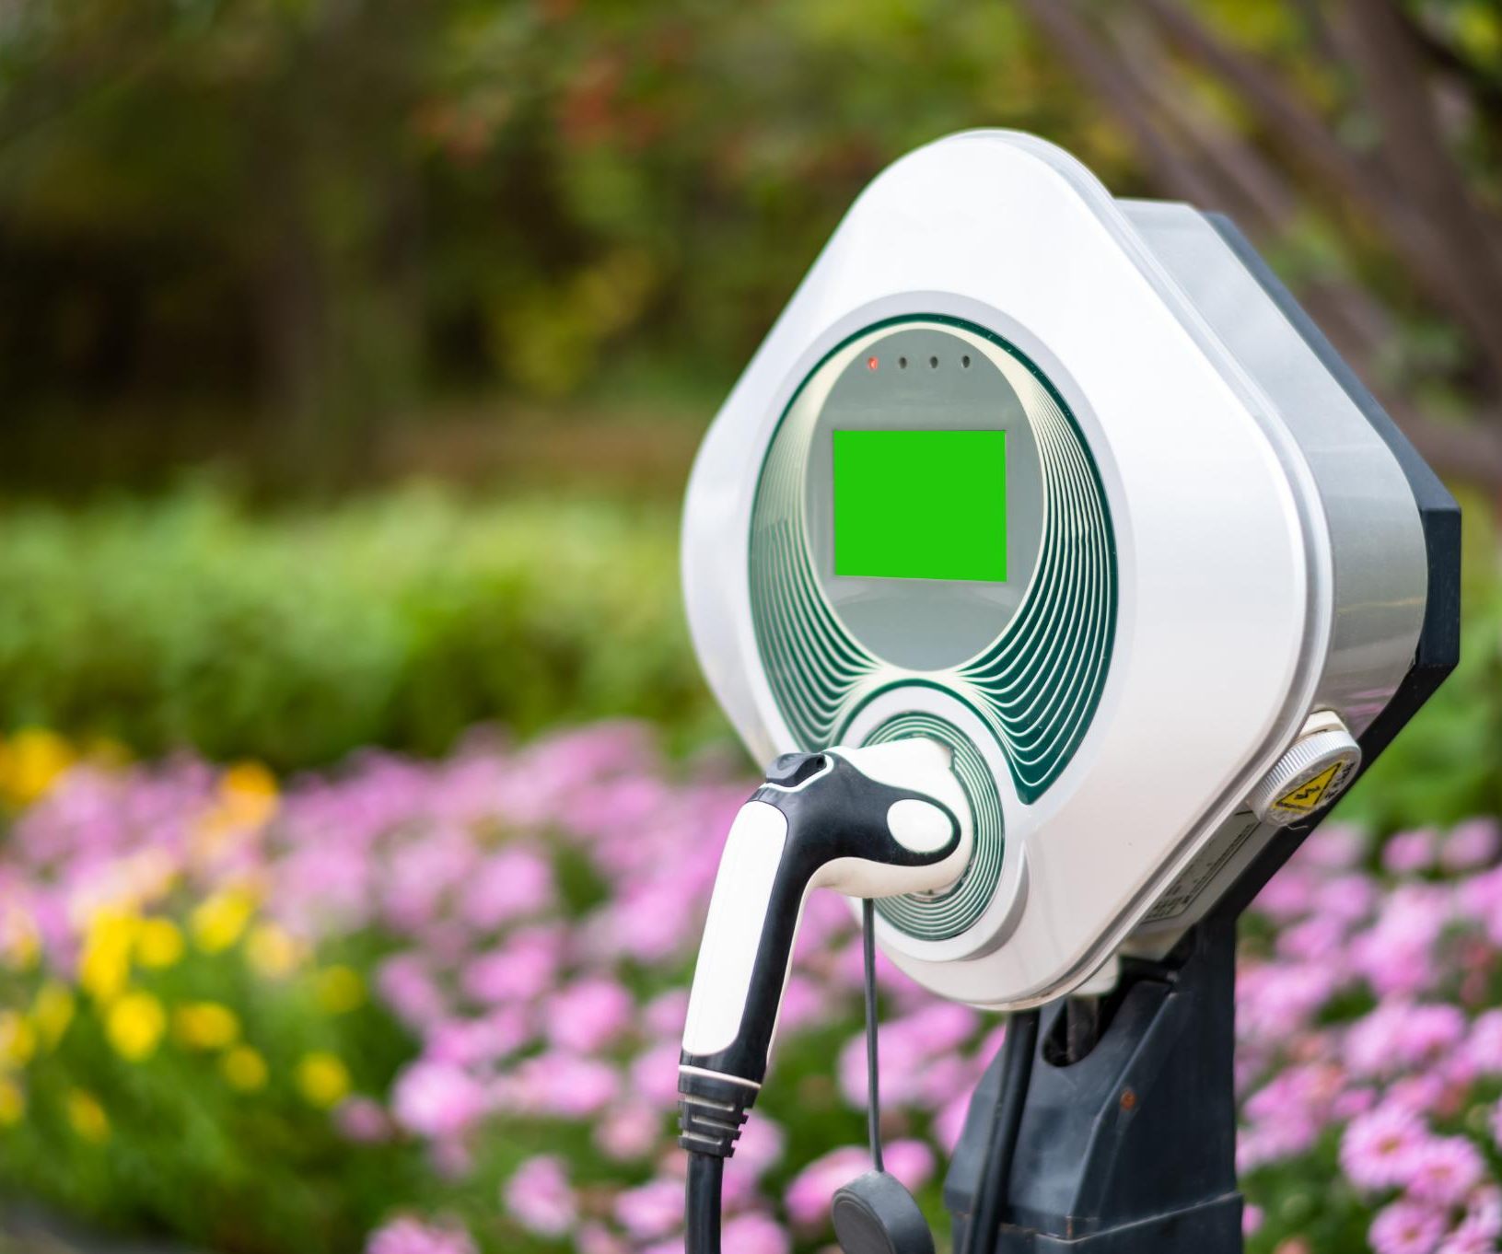
Long-Term Economic and Environmental Impacts
Economic Growth via Technology
Investment in EV infrastructure drives economic growth by fostering new technological innovations and industries.
Environmental Sustainability
Adopting EV infrastructure helps reduce environmental impact by promoting cleaner transportation aligned with sustainability goals.
Regional Sustainability Alignment
Durham’s EV investments align with broader regional trends toward sustainability and greener future planning.
Notes:
--- Investing in EV infrastructure promotes economic growth through new technologies and aligns Durham with regional sustainability trends, reducing environmental impact over time. Image source: Microsoft 365 content library

Slide 20
Conclusion
Supporting Sustainability Goals
Incorporating EV charging in site planning promotes Durham's commitment to environmental sustainability and aligns to Durhams Climate Action Goals.
Addressing Community Needs
Planning for EV infrastructure ensures accessibility and convenience for Durham’s community members including the UNH population
Aligning with Energy Policies
Integration aligns local planning with broader energy policies for a cleaner future.
Preparing for Electric Future
This proactive planning equips Durham to meet growing electric vehicle demands.
Aligns to our Climate Action Plan
Recommended Action from Durham Energy Committee: Adopt recommendations into Site Planning
Notes:
Integrating EV charging requirements into Durham’s site planning documents supports the town’s sustainability goals, addresses community needs, and ensures alignment with broader energy policies. This proactive approach prepares Durham for an increasingly electric future.

